Slide 1

Using Machine Learning to Create a Movie Recommendation System
Maxwell Owusu, Michael Womble, Yaswanth Sai Devisetti
DATS 6202

Slide 2
Type of Recommendation Filtering Systems
Collaborative Filtering
Predicts interest of a user based on the preferences and information of other users.
Simple to implement
Doesn’t require model to understand the item content
Often fails to recommend new items
Content-Based Filtering
Generate recommendations based on a user's history and profile.
Performs well when items don’t have sufficient rating data
Struggle to provide recommendations to new users
Hybrid
Looks to take advantage of the strengths of both collaborative and content-based filtering
Computationally expensive

Slide 3
Dataset Overview
MovieLens – 1M:
1 million ratings from:
6040 users – each user has at least 20 ratings
3952 movies
Movies
Ratings
Movie IDs
Title
User IDs
Movie IDs
Genres
Ratings
Timestamp
Users
User IDs
Gender
Age
Occupation
Zip-code

Slide 4
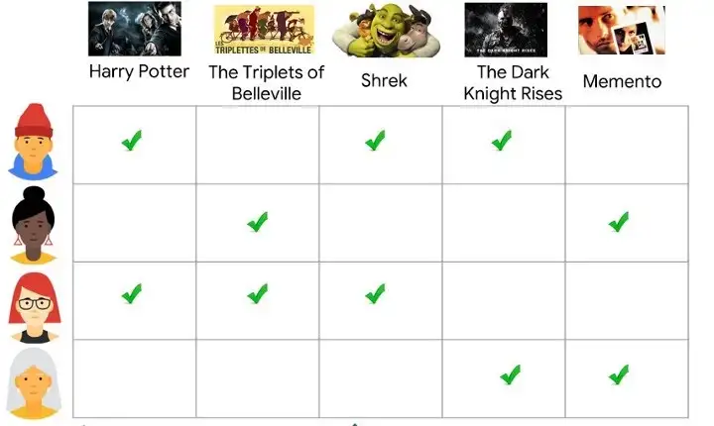
Matrix Factorization
Commonly used algorithm in collaborative filtering systems
Decomposes the user-item interaction matrix into two lower dimensionality rectangular matrices
Simplest algorithm learn the cosine similarity between users
https://vinay-bhupalam.medium.com/personalized-recommendation-systems-c6a2159445b9

Slide 5
Cosine Similarity Move Recommender

Slide 6
Predicting Movie Rating

Slide 7
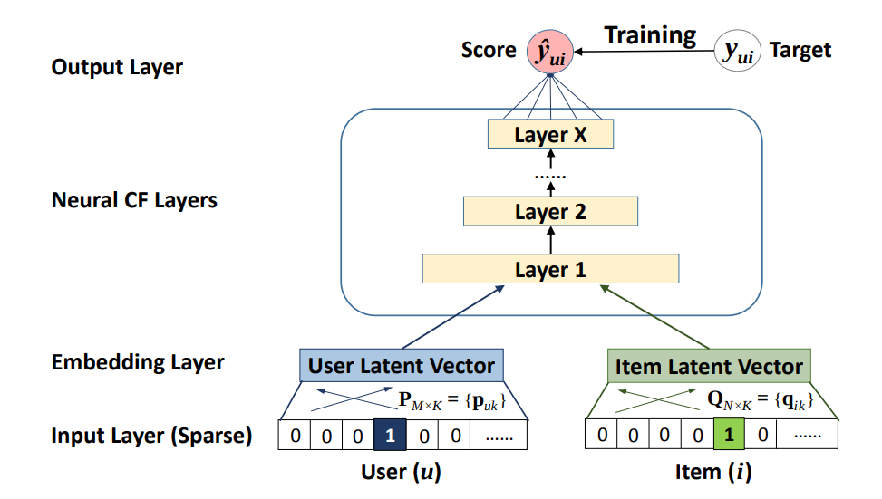
Two-Tower Model
Timestamp
Gender
Movie Description
Occupation
Genre
Movie Title
https://calvinfeng.gitbook.io/machine-learning-notebook/supervised-learning/recommender/neural_collaborative_filtering#multi-layer-perceptron

Slide 8
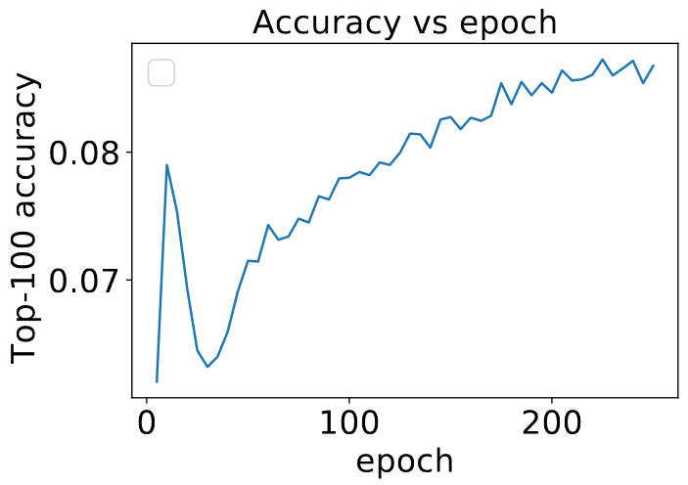
Evaluation of the Two-Tower Model
Evaluate using Top-k (100) accuracy method
For shallow (one-layer) two-tower model:
Top-100 accuracy = 9%

Slide 9
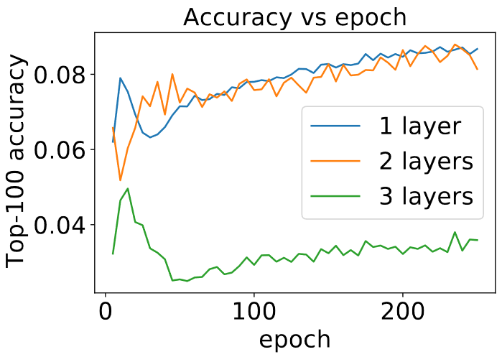
Tuning the Two-Tower Model
Layers used to learn embedding patterns

Slide 10
Conclusions

Slide 11

Questions?

